Slide 1
Natural Language Processing
Lecture 12: Text Classification

Slide 2

Is this spam?

Slide 3


Positive or negative movie review?
unbelievably disappointing
Full of zany characters and richly applied satire, and some great plot twists
this is the greatest screwball comedy ever filmed
It was pathetic. The worst part about it was the boxing scenes.

Slide 4

What is the domain of this news article?
Article
Sports
?

Slide 5
Text Classification
Assigning subject categories, topics, or genres
Spam detection
Authorship identification
Age/gender identification
Language Identification
Sentiment analysis
….

Slide 6
Classification
Given a collection of examples (training set )
Each example is represented by a set of features, sometimes called attributes
Each example is to be given a label or class
Find a model for the label as a function of the values of features.
Goal: previously unseen examples should be assigned a label as accurately as possible.
A test set is used to determine the accuracy of the model. Usually, the given data set is divided into training and test sets, with training set used to build the model and test set used to validate it.

Slide 7
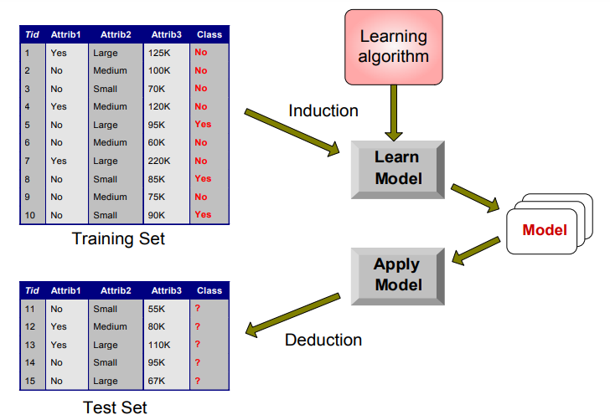
Classification: Illustration

Slide 8
Text Classification: definition
Input:
a document d
a fixed set of classes C = {c₁, c₂,…, c_{J}}
Output: a predicted class c ∈ C

Slide 9
Classification Methods: Hand-coded rules
Rules based on combinations of words or other features
spam: black-list-address OR (“dollars” AND“ have been selected”)
Accuracy can be high
If rules carefully refined by expert
But building and maintaining these rules is expensive

Slide 10
Classification Methods: Supervised Machine Learning
Input:
a document d
a fixed set of classes C = {c₁, c₂,…, c_{J}}
A training set of m hand-labeled documents (d₁,c₁),....,(d_{m},c_{m})
Output:
a learned classifier γ:d → c

Slide 11
Classification Methods: Supervised Machine Learning
Any kind of classifier
Naïve Bayes
Logistic regression
Support-vector machines
k-Nearest Neighbors
…

Slide 12
Text Classification and Naïve Bayes
Naïve Bayes (I)

Slide 13
Naïve Bayes Intuition
Simple (“naïve”) classification method based on Bayes rule
Relies on very simple representation of document
Bag of words

Slide 14
The bag of words representation
I love this movie! It's sweet, but with satirical humor. The dialogue is great and the adventure scenes are fun… It manages to be whimsical and romantic while laughing at the conventions of the fairy tale genre. I would recommend it to just about anyone. I've seen it several times, and I'm always happy to see it again whenever I have a friend who hasn't seen it yet.
γ(
)=c

Slide 15
The bag of words representation
I love this movie! It's sweet, but with satirical humor. The dialogue is great and the adventure scenes are fun… It manages to be whimsical and romantic while laughing at the conventions of the fairy tale genre. I would recommend it to just about anyone. I've seen it several times, and I'm always happy to see it again whenever I have a friend who hasn't seen it yet.
γ(
)=c

Slide 16
The bag of words representation: using a subset of words
x love xxxxxxxxxxxxxxxx sweet xxxxxxx satirical xxxxxxxxxx xxxxxxxxxxx great xxxxxxx xxxxxxxxxxxxxxxxxxx fun xxxx xxxxxxxxxxxxx whimsical xxxx romantic xxxx laughing xxxxxxxxxxxxxxxxxxxxxxxxxxxxxxxxxxxxxxxxxxxx recommend xxxxx xxxxxxxxxxxxxxxxxxxxxxxxxxxxxxxx several xxxxxxxxxxxxxxxxx xxxxx happy xxxxxxxxx again xxxxxxxxxxxxxxxxxxxxxxxxxxxxxxxxxxxxxxxxxxxxxxx
γ(
)=c

Slide 17
The bag of words representation
great | 2
love | 2
recommend | 1
laugh | 1
happy | 1
... | ...
γ(
)=c

Slide 18
Bag of words for document classification
?
Test
document
Machine Learning
parser
language
label
translation
…
NLP
Garbage
Collection
Planning
GUI
learning
training
algorithm
shrinkage
network...
parser
tag
training
translation
language...
garbage
collection
memory
optimization
region...
planning
temporal
reasoning
plan
language...
...

Slide 19
Text Classification and Naïve Bayes
Formalizing the Naïve Bayes Classifier

Slide 20
Bayes’ Rule Applied to Documents and Classes
For a document d and a class c

Slide 21
Naïve Bayes Classifier (I)
MAP is “maximum a posteriori” = most likely class
Bayes Rule
Dropping the denominator

Slide 22
Naïve Bayes Classifier (II)
Document d represented as features x1..xn

Slide 23
Naïve Bayes Classifier (IV)
O(|X|^{n}•|C|) parameters
How often does this class occur?
Could only be estimated if a very, very large number of training examples was available.
We can just count the relative frequencies in a corpus

Slide 24
Multinomial Naïve Bayes Independence Assumptions
Bag of Words assumption: Assume position doesn’t matter
Conditional Independence: Assume the feature probabilities P(x_{i}|c_{j}) are independent given the class c.

Slide 25
Multinomial Naïve Bayes Classifier

Slide 26
Applying Multinomial Naive Bayes Classifiers to Text Classification
positions ← all word positions in test document

Slide 27
Learning the Multinomial Naïve Bayes Model
Sec.13.3
First attempt: maximum likelihood estimates
simply use the frequencies in the data

Slide 28
Parameter estimation
fraction of times word w_{i} appears
among all words in documents of topic c_{j}
Create mega-document for topic j by concatenating all docs in this topic
Use frequency of w in mega-document

Slide 29
Problem with Maximum Likelihood
Sec.13.3
What if we have seen no training documents with the word fantastic and classified in the topic positive (thumbs-up)?
Zero probabilities cannot be conditioned away, no matter the other evidence!

Slide 30
Laplace (add-1) smoothing for Naïve Bayes

Slide 31
Multinomial Naïve Bayes: Learning
From training corpus, extract Vocabulary
Calculate P(c_{j}) terms
For each c_{j} in C do
docs_{j} ← all docs with class =c_{j}
Calculate P(w_{k} | c_{j}) terms
Text_{j} ← single doc containing all docs_{j}
For each word w_{k} in Vocabulary
n_{k} ← # of occurrences of w_{k} in Text_{j}

Slide 32
Laplace (add-1) smoothing: unknown words
Add one extra word to the vocabulary, the “unknown word” w_{u}

Slide 33
Document Id | Text | Class
1 | Nvidia GPU is the best in the world. | computer graphics
2 | Nvidia is giving tough competition to AMD. | computer graphics
3 | We were running our application with GTX 1050(High end GPU) still it didn't work then we realized the problem was with the OS. | computer graphics
4 | Punjab University, is located in Lahore. | not computer graphics
5 | Lahore is capital of Punjab | Not computer graphics
6 | UET is located in Lahore | Not computer graphics
7 | Please buy GPU from our store. | ?

Slide 34
Features
NVIDIA
GPU
AMD
GTX1050
Punjab
Lahore

Slide 35
Data
Doc Id | Text | Class
1 | Nvidia GPU is the best in the world. | computer graphics
2 | Nvidia is giving tough competition to AMD. | computer graphics
3 | We were running our application with GTX 1050(High end GPU) still it didn't work then we realized the problem was with the OS. | computer graphics
4 | Punjab University, is located in Lahore. | not computer graphics
5 | Lahore is capital of Punjab | Not computer graphics
6 | UET is located in Lahore | Not computer graphics
7 | Please buy GPU from our store. | ?
Doc Id | NVIDIA | GPU | AMD | GTX1050 | Punjab | Lahore | Label
1 | 1 | 1 | 0 | 0 | 0 | 0 | CG
2 | 1 | 0 | 1 | 0 | 0 | 0 | CG
3 | 0 | 1 | 0 | 1 | 0 | 0 | CG
4 | 0 | 0 | 0 | 0 | 1 | 1 | NCG
5 | 0 | 0 | 0 | 0 | 1 | 1 | NCG
6 | 0 | 0 | 0 | 0 | 0 | 1 | NCG
7 | 0 | 1 | 0 | 0 | 0 | 0 | ?

Slide 36
P(NVIDIA|CG)
P(NVIDIA|NCG)
P(GPU|CG)
P(GPU|NCG)
P(Punjab|CG)
P(Punjab|NCG)

Slide 37
P(GC) = 3/6 = 0.5
P(NCG) = 3/6 = 0.5
P(GPU|CG) = Count of word GPU in class CG / Count of all words of CG

